Slide 1
Hot Meals CS3343 Group Presentation
Banbah, Kush: 55786740
Gupta, Aarnav: 55990960
Jain, Utkarsh: 55992915
Kasliwal, Aryan Girish: 55972222
Malhotra, Avi: 55773896
Rajagopalan, Pratul: 55858290

Slide 2
Meet the Team
Avi: Programmer
Utkarsh: Assistant PM
Pratul: Test Lead
Aryan: PM
Aarnav: Scrum Master
Kush: Programmer

Slide 3
Project Introduction
Hot Meals is an application developed to reduce waiting times for customers and help restaurant plan out their meals

Slide 4
Project requirements
Objectives | Requirements
Efficiency | Minimize waiting time for customers
 | Efficient seat management
 | Kitchen time management
Scalability | Multiple restaurant locations
 | Multiple dishes and dish types per location
 | Variable restaurant capacity
Profit maximization | Organize table reservation to always ensure maximal seat usage
 | First-to market, innovative solution

Slide 5
Solution goals
Customer should be able to make a booking with their order and get a time to arrive from the restraunt
They should be able to make a booking for number of people at any location
They can delete or view booking details later
Once a booking is made, the time selected must be free enough for the restraunt to be able to prepare the meal and have seats so the customer doesn't have to wait.

Slide 6
Our solution
Efficiency:
Designed and implemented efficient algorithms to calculate the available time and seats to the customer.
Scalability:

Slide 7
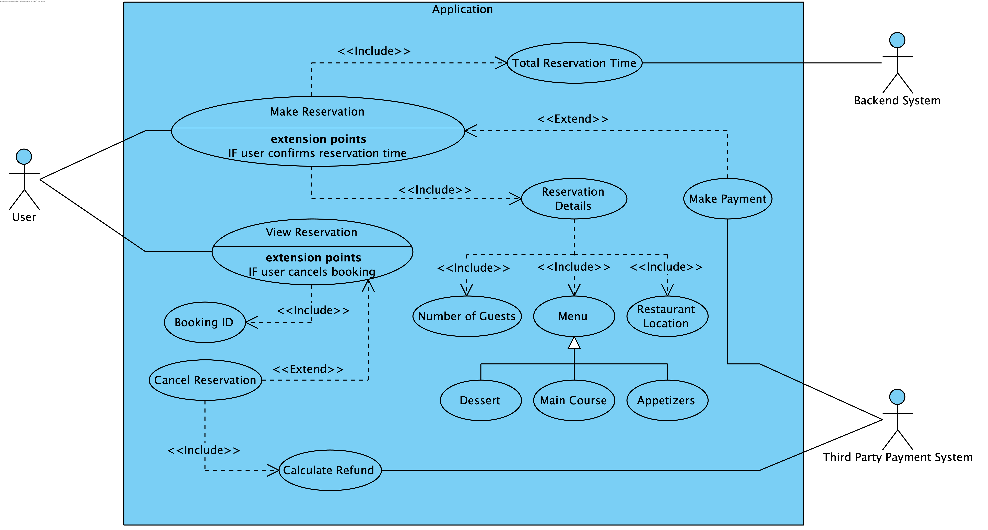
Use Case Diagram

Slide 8
Class Diagram

Slide 9
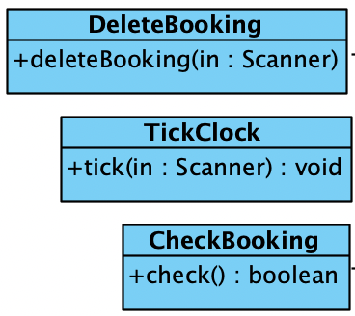
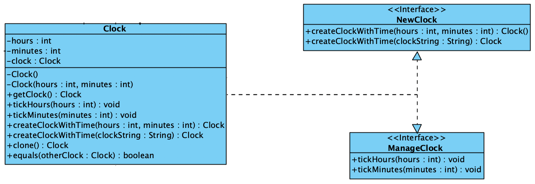
Design Principles
Global Principles:
Open Close Principle
Law of Demeter
Liskov Substitution Principle
Specific designs:
Single Responsibility Principle
Interface Segregation Principle

Slide 10
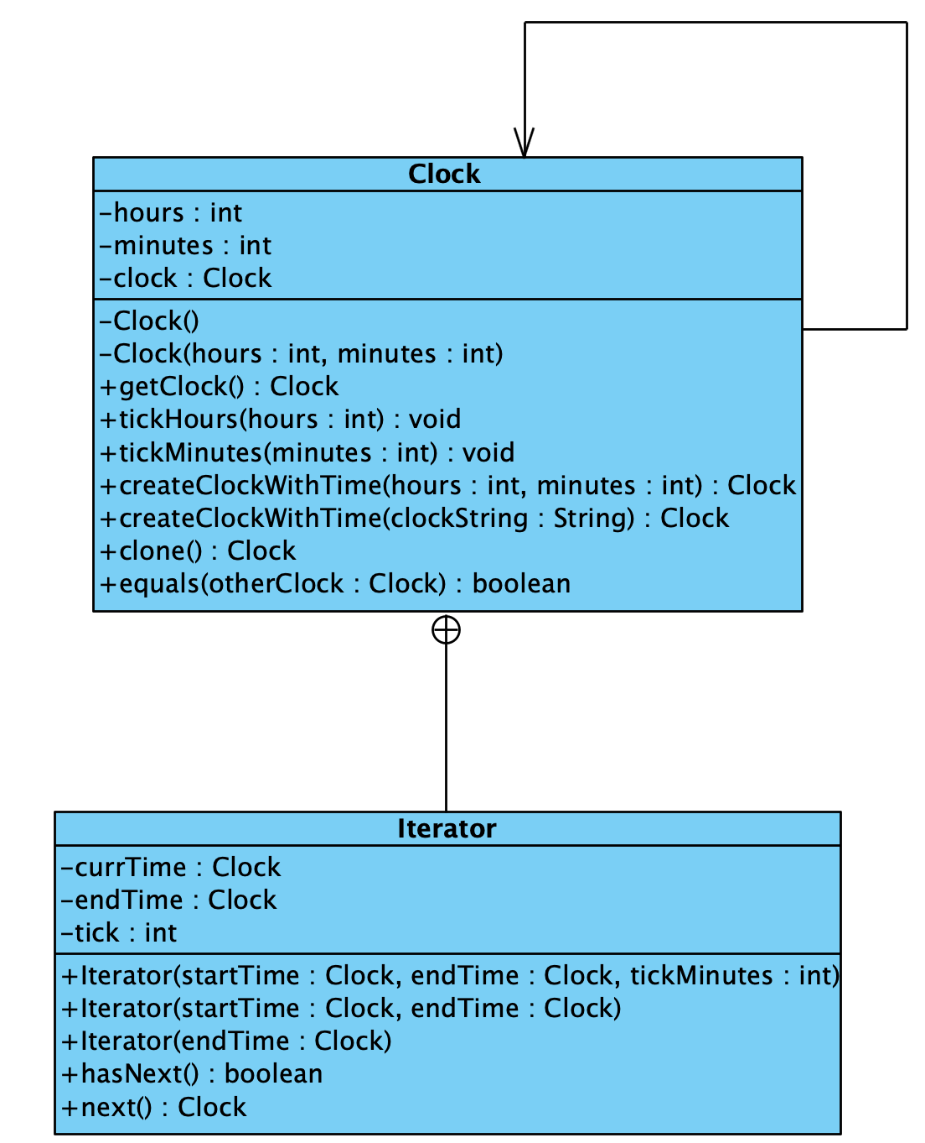
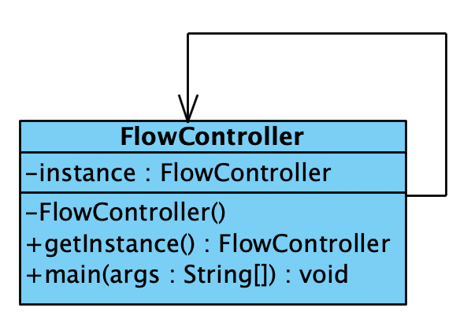
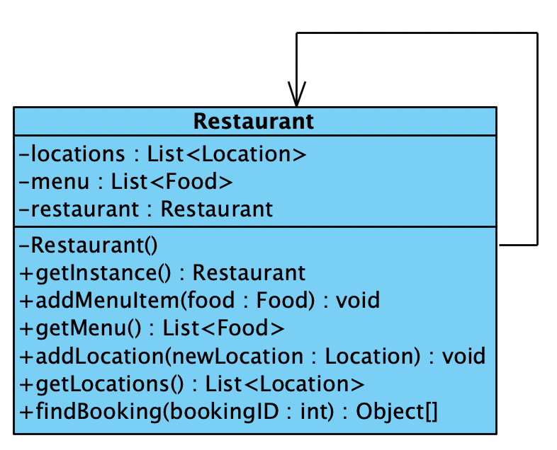
Design Patterns (Singleton and Façade)

Slide 11
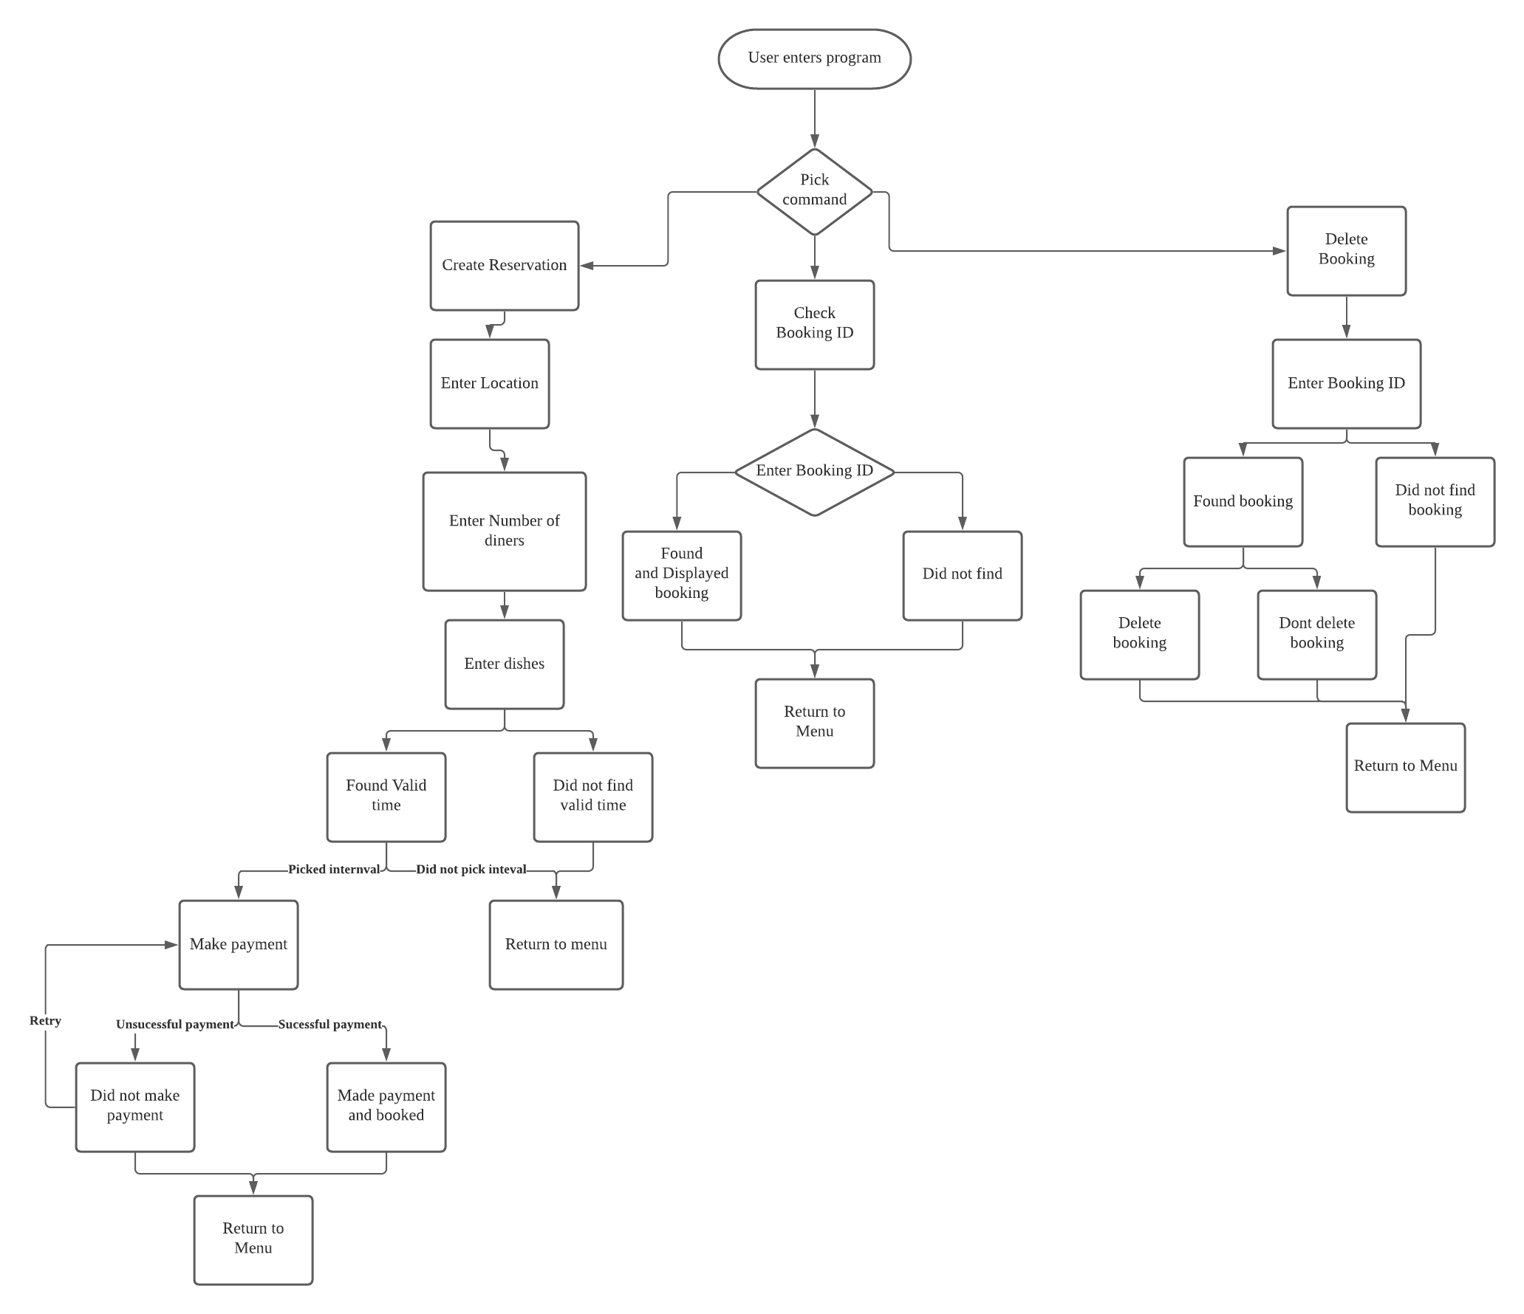
Story Line
User has 3 options
Delete booking and Check Booking
Create reservation
Notes:
Hi, so to begin, I'll go over the storyline or the user choices
The 'user' has 3 choices, I'll start with the most complex which is create reservation
The customer will enter location, number of diners and then dishes
Once they enter dishes, the backend system will generate a list of intervals
The customer can then select their internval or return to menu
Once they select it, we proceed to payment,
If payment fails the customer can retry to exit to menu or it will suceed then the booking will be made
Alternatively, the customer can check and delete booking ID as well from the menu
They can enter a booking id, if it's found it's details will be shown or else an did not find message and the program will return to menu
If customer chose delete booking and the booking was found, the customer can see the details and decide to cancel their reservation or not, after this decision we again return to menu
The application can be ended from the menu, and as you can see all paths lead back to menu and accomplish the requirements

Slide 12

Software development style
Process was split into different versions using prototype-waterfall development style
Each iteration of the protype was developed in waterfall style
Planning->Coding->Testing
Notes:
Lets now go over the software development process.
The process

Slide 13
Design of each prototype
Version 1: Base functionality
Version 2: Added additional features to accomplish requirements
Version 3: Added stability via error handling and refactoring

Slide 14
Code refactoring strategies used
Extract method - Separate large method into sub methods for easier testing and better modularity
Moving child fields to parent class – certain fields were replicated in every child class so they were moved to parent instead
Group parameters into a class – Moved fields to an object to make it easier to keep track of arguments
Extracting method from code body – Method was extracted into a different class more suited for to also help enforce encapsulation

Slide 15
Testing Process
Bottom-Up Method
Parallelism
Easy planning and controlling
Easy to test
No Test Stubs

Slide 16
Unit Testing
Classes that were unit tested
Bill
Reader
Time Period
Food
Clock

Slide 17
Integration Testing
Payment + Bill
Reservation + Bill
Location + Reservation
Restaurant + Location + Food
Check Booking + Restaurant
Delete Booking + Restaurant
Tick Clock + Clock
Iterator + Clock

Slide 18
System Testing
Testing all classes together

Slide 19
Instance of a Bug Report
Intervals are starting 1 tick late and ending 1 tick early
Project: | “Hot Meal” - A Reservation Manager | “Hot Meal” - A Reservation Manager
Project Version: | Ver 2 | Closed
Created: | 10 Nov 2021 | Resolved: | 14 Nov 2021
Status: | Closed | Severity: | Major
Reporter: | Pratul | Assigned to: | Kush
Environment: | Windows 10
Attachments: | Output.png; stackTrace.png
Description: | The system seems to miss the starting and the ending interval

Slide 20
Tools Used
Development Tools
Visual Studio Code
IntelliJ
Development Platform
macOS Monterey - 12.0.1
macOS Big Sur – 11.6.1
Testing
Junit
Eclipse
macOS Catalina – 10.15
Windows 10
Collaboration Tools
Zoom
GitHub
Documentation
& Presentation
Visual Paradigm
MS Word
Apple Pages
MS PowerPoint

Slide 21
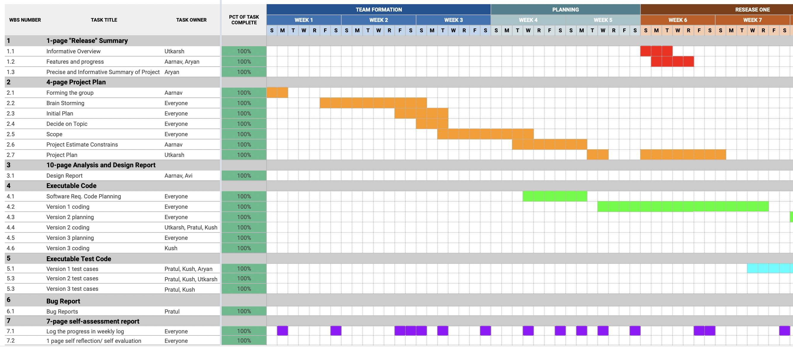
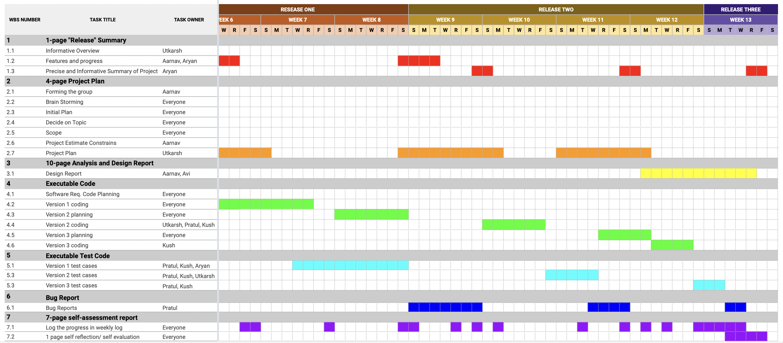
Gannt Chart

Slide 22
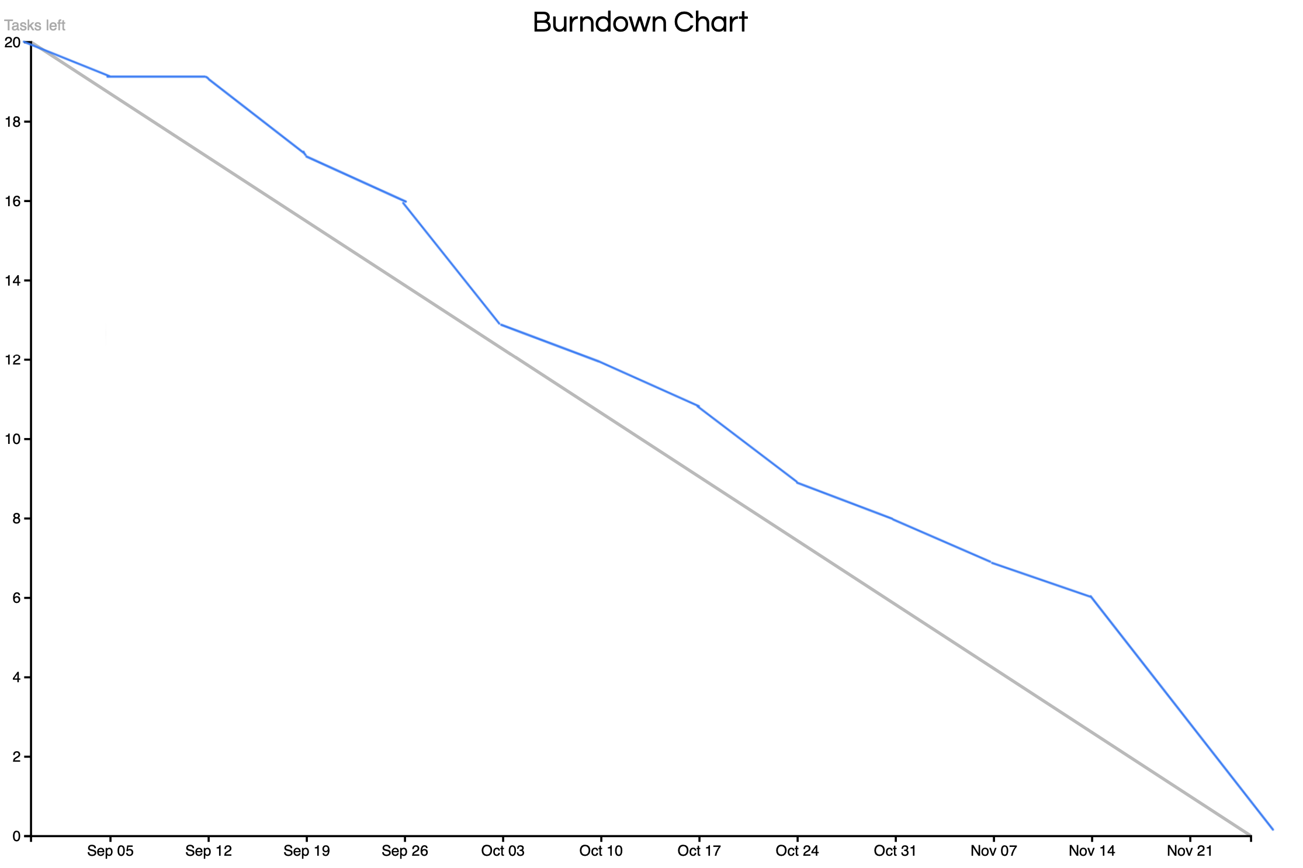
Burndown Chart

Slide 23
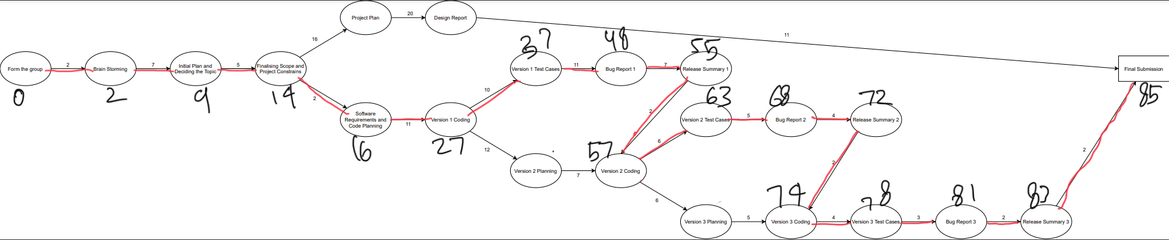
Activity Path

Slide 24
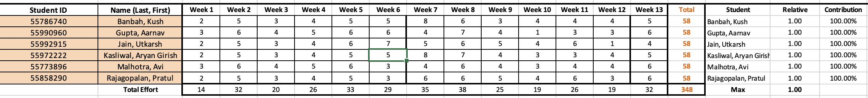
Activity Sheet

Slide 25
DEMO

Slide 26
